Slide 1

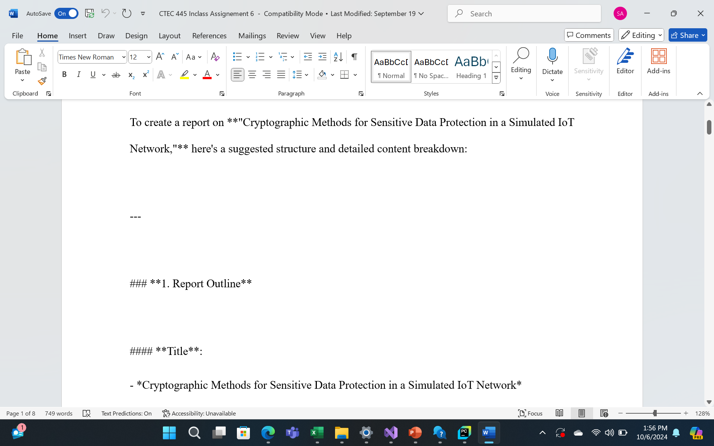
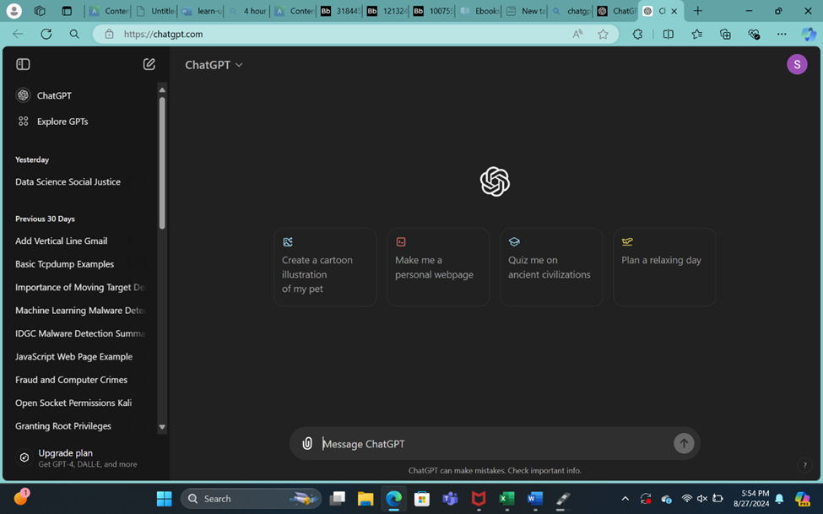
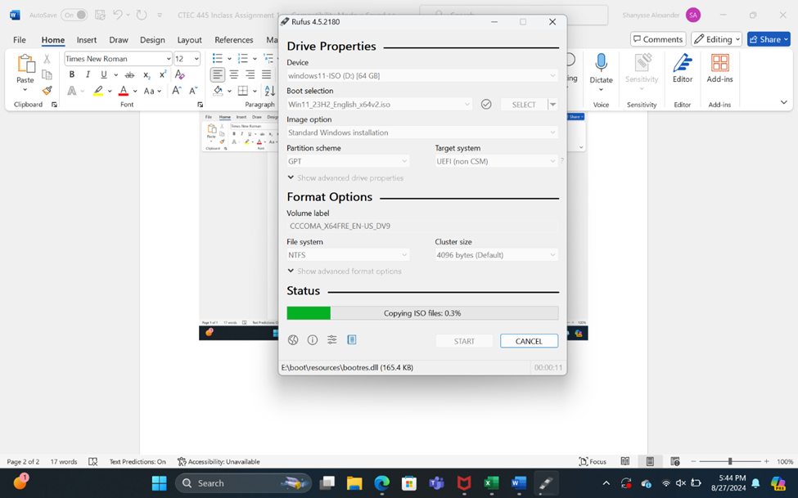
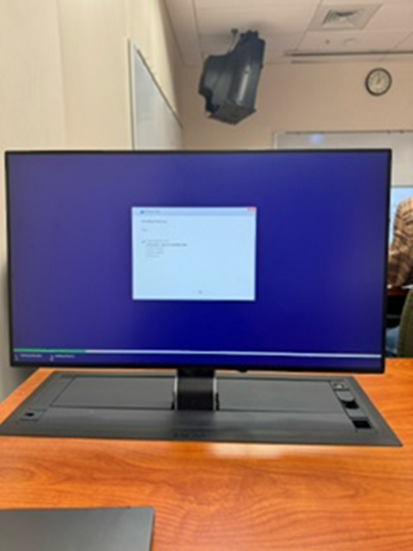
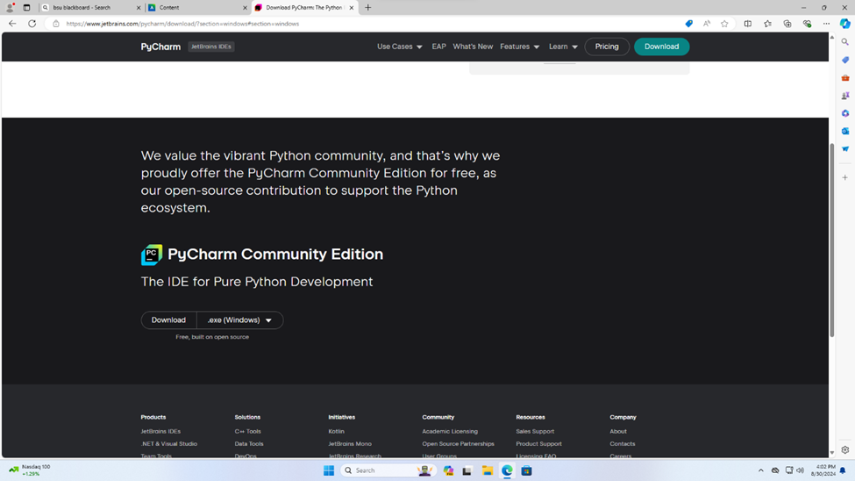
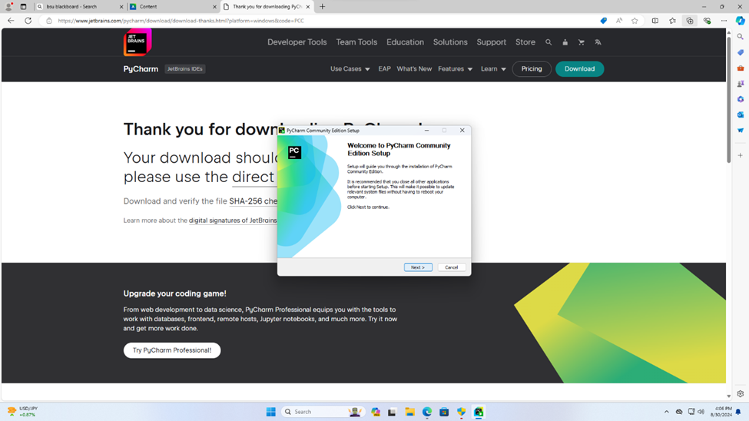
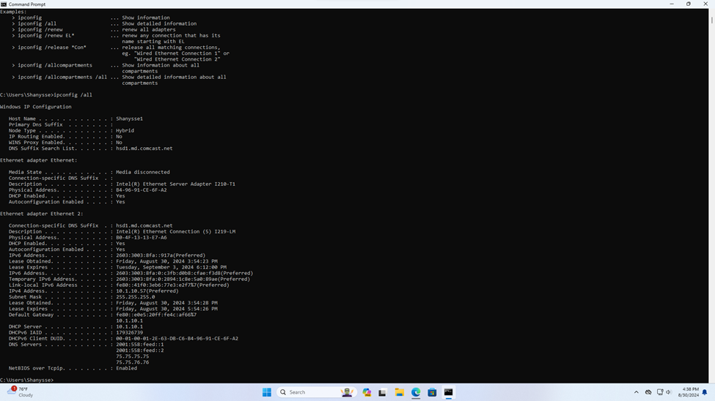
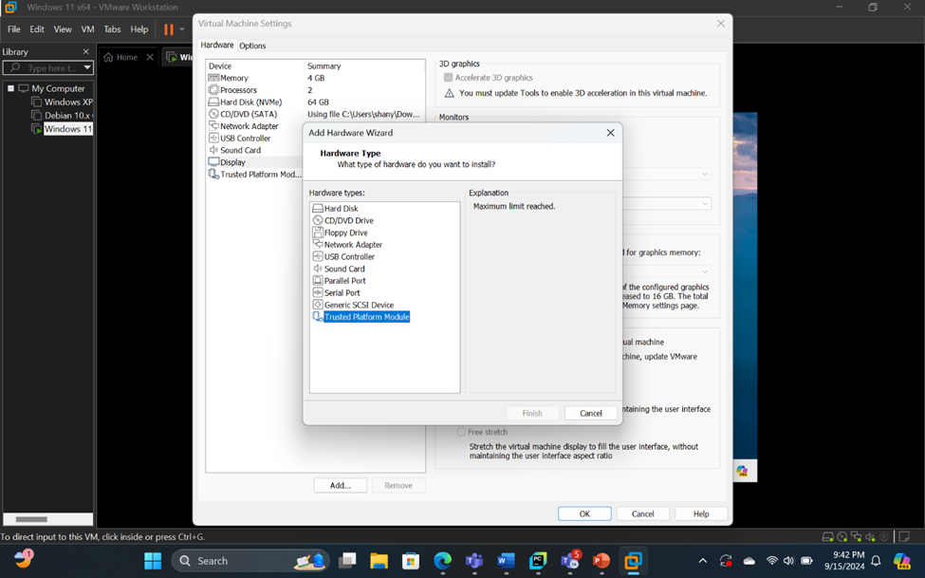
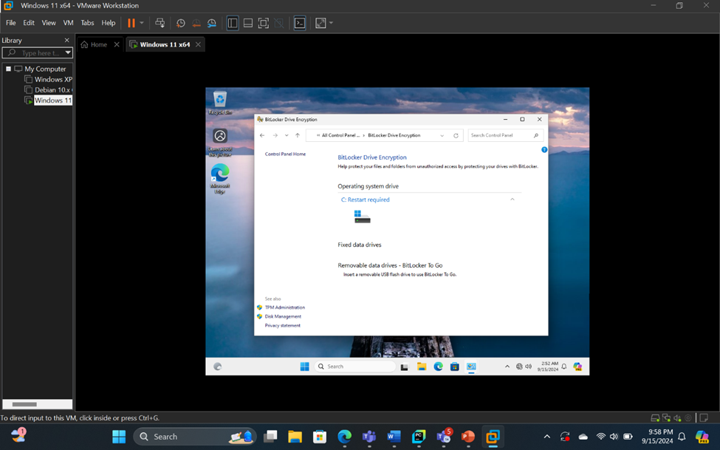
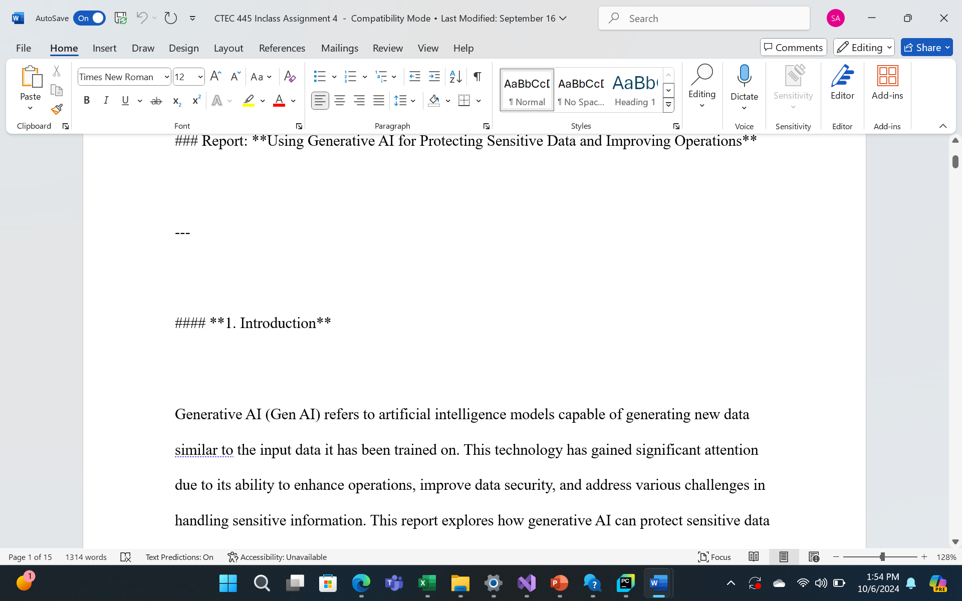
ABSTRACT
The Inclass Assignments for this class covered how to use ChatGPT, installing Windows 11, installing PyCharm Windows command line tools, and BitLocker.,
INTRODUCTION
The Inclass Assignments are a way to get a hands-on experience of the topics covered in the class. Mainly the Inclass assignments cover how to use Generative AI, specifically ChatGPT. The assignments also cover different Windows tools that be used to protect your device and command line tools as well.
CTEC 445 Seminar Poster
Shanysse Alexander, CTEC 445
METHODS & Results
How to use Chat GPT, Installing Windows, Installing Pycharm
Windows Command Line Tools
Bitlocker
Using ChatGPT to write research
CONCLUSION
Overall, the Inclass assignments provide a great way to better understand the concepts of the class. The class covers mainly the use of Generative AI. The Inclass assignments have a lot of activities with a focus on the Generative AI platform ChatGPT. The Inclass assignments also cover how to install and use different tools and software for coding and protecting your device
ACKNOWLEDGEMENTS
-My family
-Dr. Haydar
6. ChatGPT Project 2

